Slide 1
Dynamic Analysis of Bike Purchase Dataset
Team Members:
Farhan Ibtesham Joy(2022-3-60-150)
Sheikh Sarafat Hossain (2022-3-60-109)
Rijia Parveen Raya (2022-3-60-192)
Instructor:
Puja Chakroborty

Slide 2



Introduction
Why This Project?
Knowing who buys bikes helps businesses sell better.
Businesses can improve sales by learning about customer’s behaviour and trends.
Enhancing inventory management, pricing strategies, and effective marketing.
Our Goal:
Use past data to predict if a customer will buy a bike.

Slide 3
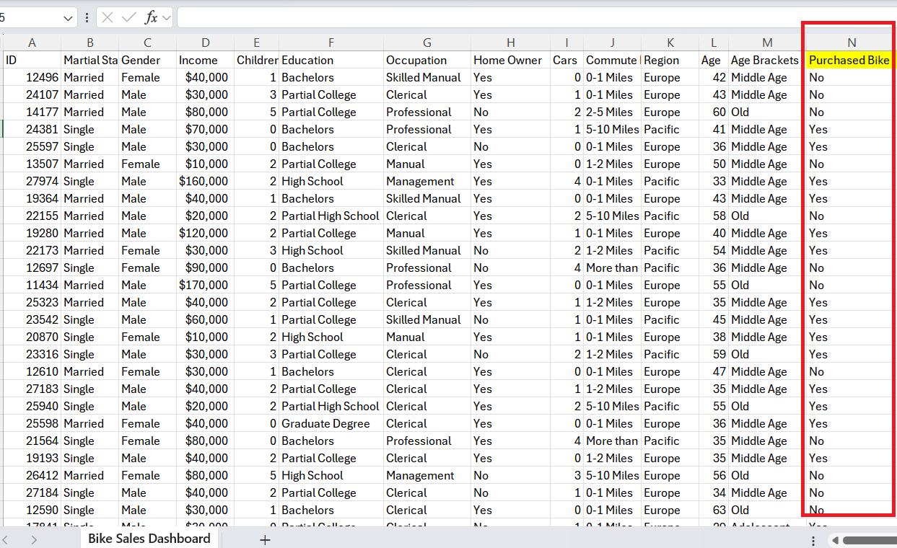
Problem Statement
Analyzing a bike sales dataset.
Creating a machine learning model to predict bike purchases.

Slide 4
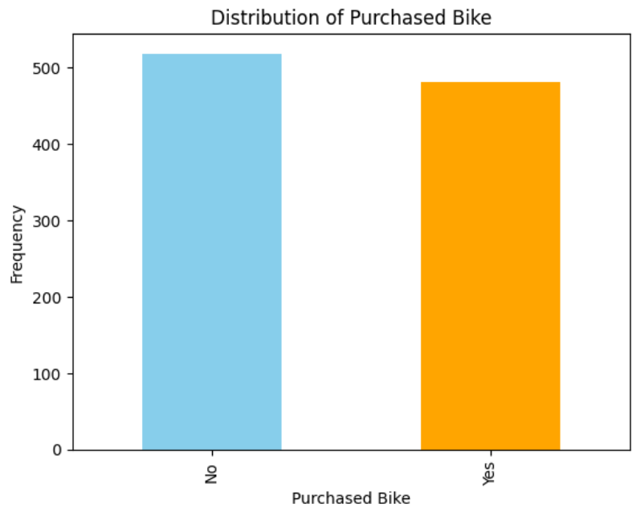
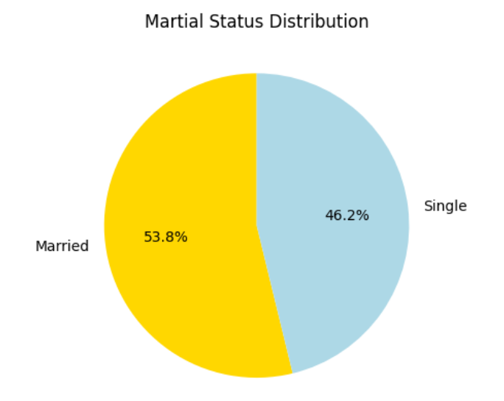
Methodology
Preparing the Data
Fixed missing values.
Encode categorical variables
Made the numbers easy to compare (normalization).
Exploring the Data 1. Made graphs and charts to find patterns. Also, Found important factors like age and income.

Slide 5
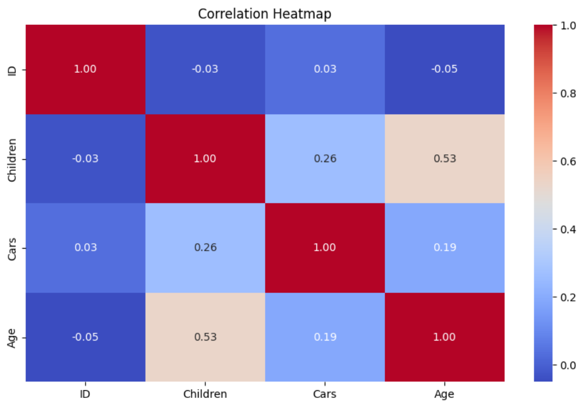
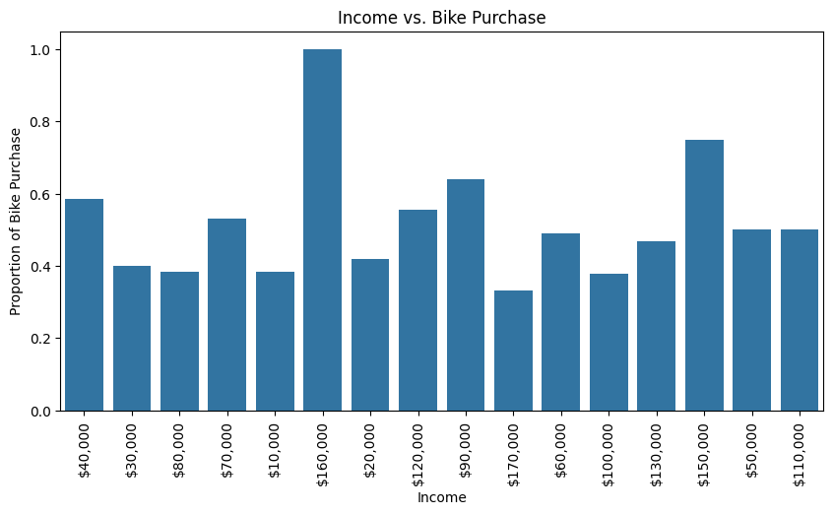
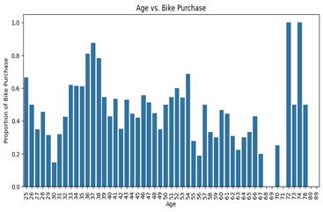
Visualization
Representing connections between feature correlation through heatmaps .
Scatter plots showing income vs. age and their relationship to bike purchases.

Slide 6
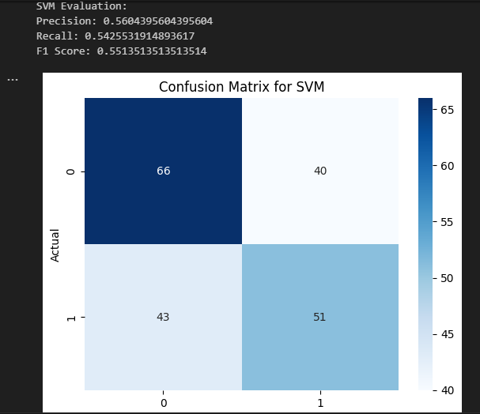
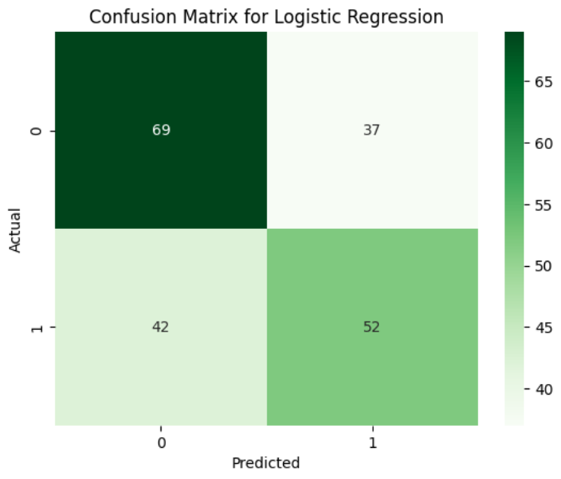
Confusion Matrix and F1 Score graphs for model performance.
SVM Of Linear Regression
SVM Of Logistic Regression

Slide 7
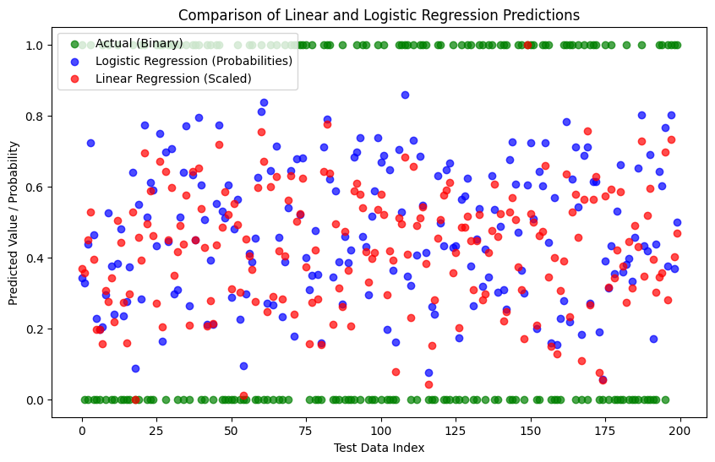
Building Models
Used Logistic Regression and Linear Regression.

Slide 8
Future Directions: What’s Next?
Why It’s Useful?
Businesses can use this to sell smarter and serve customers better.
Cost Savings: Reduces waste by optimizing resources and inventory.
Collect more data like- sales during holidays or promotions to improving predictions
Try advanced models like random forest for better accuracy.
Use real-time data to make predictions faster and accurate.

